Slide 1
Explanation techniques for neural networks
Laura Rieger

Slide 2
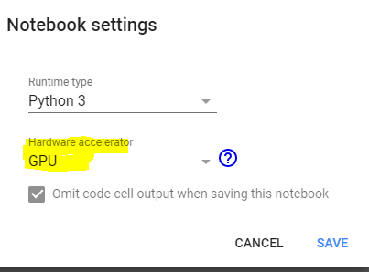
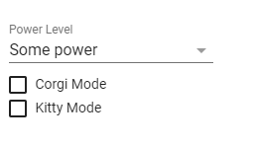
Colab notebook
Colab notebook:
bit.ly/2PdScxx
File -> Save a Copy in Drive
Edit -> Notebook settings -> GPU
Tools -> Preferences -> Misc ->

Slide 3
Intro
Assumptions
Complicated non-linear task
Can not be solved by an intuitively explainable model
Complete understanding is not possible
Single decision explanations
Region-based explanations
Approaches
Backpropagation
Local approximation with simple model
Notes:
Basic assumption: task too complicated for basic perceptron.
Neural network is too complicated for complete understanding.
Need to restraint understanding to part of the network of it – either only how network worked for single example, how single neuron/layer works or how concept
Mostly with keras

Slide 4
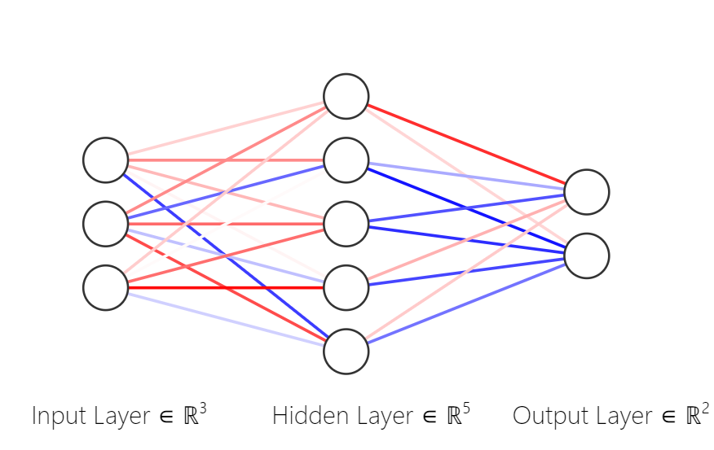
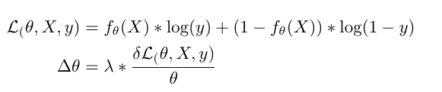
Neural Networks
Complex function composed of smaller functions
Trained by large amounts of labelled data
Training:
Differentiate loss over weights
Update weights
Differentiation done automatically

Slide 5

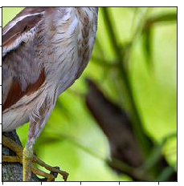
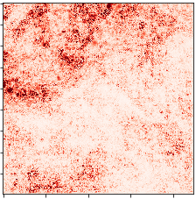

Saliency [1]
Want to know what parts of the input responsible for the output
Areas with a high gradient
Output changes fast here
Probably important
Output is fully differentiable
Basic explainability method
Super noisy
High redundancy
Noisy function
Popular variant: Guided Backprop [9]

Slide 6

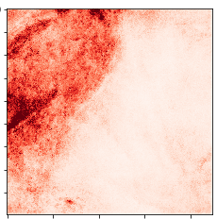
SmoothGrad [15]
How do we remove noise? With more noise!
Average over number of input with noise added
Clears up image
Applicable to all basic explanation techniques

Slide 7

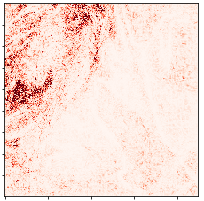
Integrated Gradients [16]
How do we remove noise? With more noise!
Average over samples on the pathway between baseline
Dependent on choice of baseline (all black, average, …)
Recent extension: use samples as baseline

Slide 8
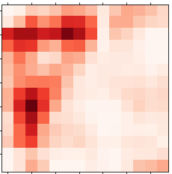
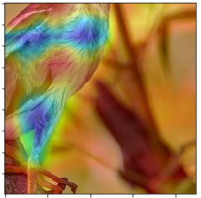
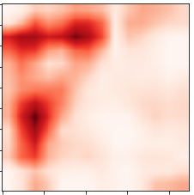
GradCAM [13]
Gradient-weighted Class Activation Mapping
Way less noisy
No finegrained input
Procedure:
Calculate gradient to last convolutional layer
Average gradient for each channel
Multiply average gradient with all activations
Average over all channels
Upsample
Notes:
TODO: add image

Slide 9
Other methods based on backpropagation
LRP [12]
Expected Gradients [17]
CAM [2]
GuidedBackprop [9]

Slide 10
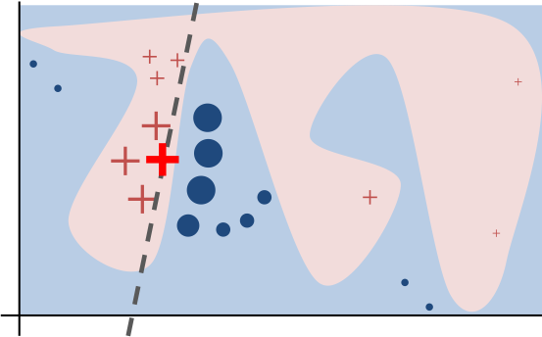
Local approximation with interpretable model – LIME [4]
Intuition:
Sample around x
Weigh samples according to distance
Train linear classifier
Obtain explanation
Low-dimensional representation necessary
For images: segment into super-pixels
For text: bag of words
From https://github.com/marcotcr/lime
Notes:
TODO read more about method

Slide 11
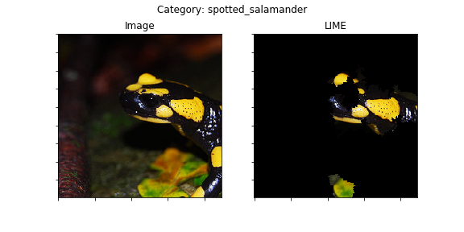
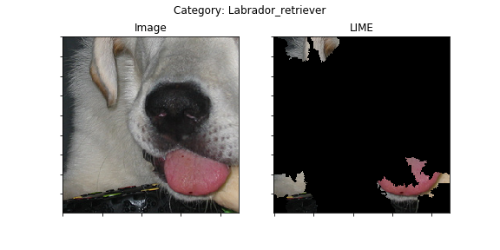
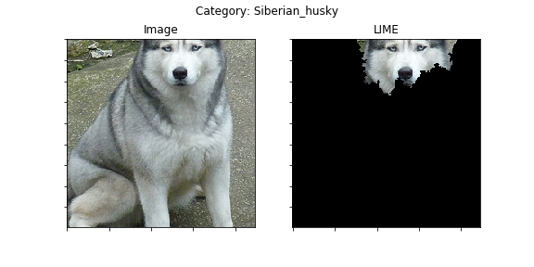
Local approximation with interpretable model – LIME [4]
Intuition:
Sample around x
Weigh samples according to distance
Train linear classifier
Obtain explanation
Low-dimensional representation necessary
For images: segment into super-pixels
For text: bag of words
Images obtained with LIME library
from pretrained VGG16
Notes:
We see examples of that on the right
Obtained with standard LIME, set to choosing the most important five super-pixels
See failure in the second image – due to having to find a low-dimensional representation it does not work well when there is not a definite object
TODO: needs to be in notebook

Slide 12
Higher-level
Network level explanations
Requires domain knowledge
Interesting for risk and fairness analysis
Two approaches presented
Analyzing specific network parts
Analyzing specific aspects
Notes:
Previously looked at approximating for a single input
There are also other ways you can focus on a different part of a network

Slide 13
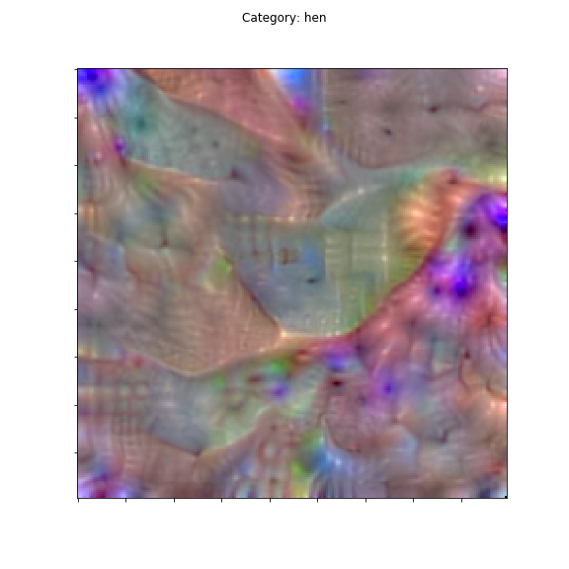
Probing the network
“Understanding Neural Networks Through Deep Visualization” [5]
Idea: iteratively optimize activation of neurons with backpropagation
Regularize to encourage realisism
For output or intermediate layers
Alternatives
Bau, David, et al. "Network Dissection: Quantifying Interpretability of Deep Visual Representations." Computer Vision and Pattern Recognition (CVPR), 2017 IEEE Conference on. IEEE, 2017.
Alain, Guillaume, and Yoshua Bengio. "Understanding intermediate layers using linear classifier probes." (2016).
Obtained with kerasvis
from pretrained VGG16
Notes:
TOD: add one more

Slide 14
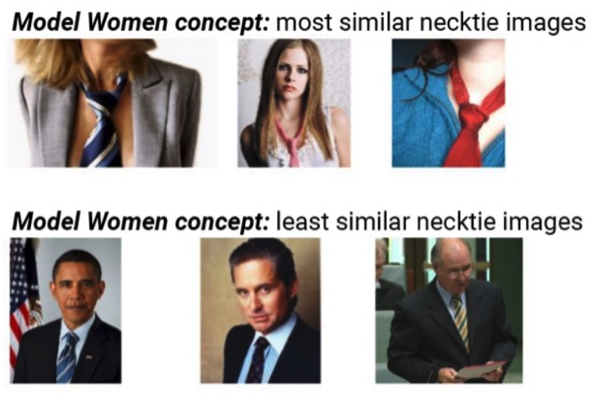
Testing with Concept Activation Vectors CAV
Proposed by Kim et al [8]
Requires high domain knowledge
Idea:
assemble dataset {P,N}
Train linear classifier on representation of given layer
Obtain weights
Useful for
Evaluating given input
Identifying a known bias in dataset and model
Kim, Been, et al.
"TCAV: Relative concept importance testing with Linear Concept Activation Vectors." (2018).
Notes:
Idea: Look how a specific human defined concept is used in the network
Really different from the rest – now we are dealing with a translation from human to network
Idea: assemble dataset of positive examples for my concept

Slide 15
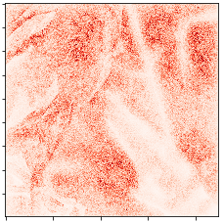
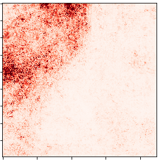
What should I use?
How do we evaluate interpretation methods?
Humans are really bad evaluators
Theoretical properties
Sanity checks
Human evaluation
Fooled by clearness
Remove input consecutively
Integrated Gradients on random weights

Slide 16
Take-away
We have to make a trade-off when obtaining explanations from NNs
Different approaches have different pros and contras
Task in question needs to be considered
 | Fidelity | Understandability | Sufficiency | Low construction overhead | Efficiency
Backprop | + | - | o | + | +
Local | o | + | o | + | -
High-level | + | + | - | - | o

Slide 17
References
Simonyan, Karen, Andrea Vedaldi, and Andrew Zisserman. "Deep inside convolutional networks: Visualising image classification models and saliency maps." arXiv preprint arXiv:1312.6034 (2013).
Zhou, Bolei, et al. "Learning deep features for discriminative localization." Proceedings of the IEEE Conference on Computer Vision and Pattern Recognition. 2016.
Zhang, Quanshi, Ying Nian Wu, and Song-Chun Zhu. "Interpretable Convolutional Neural Networks.”
Ribeiro, Marco Tulio, Sameer Singh, and Carlos Guestrin. "Why should i trust you?: Explaining the predictions of any classifier." Proceedings of the 22nd ACM SIGKDD international conference on knowledge discovery and data mining. ACM, 2016.
Yosinski, Jason, et al. "Understanding neural networks through deep visualization." In ICML Workshop on Deep Learning.
Bau, David, et al. "Network dissection: Quantifying interpretability of deep visual representations." arXiv preprint arXiv:1704.05796 (2017).
Alain, Guillaume, and Yoshua Bengio. "Understanding intermediate layers using linear classifier probes." arXiv preprint arXiv:1610.01644 (2016).
Kim, Been, et al. "TCAV: Relative concept importance testing with Linear Concept Activation Vectors." (2018).
Springenberg, Jost Tobias, et al. "Striving for simplicity: The all convolutional net." arXiv preprint arXiv:1412.6806 (2014).
1Zhang Q, Wu YN, Zhu S-C. Interpretable Convolutional Neural Networks. https://arxiv.org/pdf/1710.00935.pdf. Accessed February 20, 2018.
Smilkov, Daniel, et al. "Smoothgrad: removing noise by adding noise." arXiv preprint arXiv:1706.03825 (2017).
Bach, Sebastian, et al. "On pixel-wise explanations for non-linear classifier decisions by layer-wise relevance propagation." PloS one 10.7 (2015): e0130140.
Selvaraju, Ramprasaath R., et al. "Grad-CAM: Visual Explanations from Deep Networks via Gradient-Based Localization." ICCV. 2017.
Swartout, William R., and Johanna D. Moore. "Explanation in second generation expert systems." Second generation expert systems. Springer, Berlin, Heidelberg, 1993. 543-585.
Smilkov, Daniel, et al. "Smoothgrad: removing noise by adding noise." arXiv preprint arXiv:1706.03825 (2017).
Sundararajan, Mukund, Ankur Taly, and Qiqi Yan. "Axiomatic attribution for deep networks." Proceedings of the 34th International Conference on Machine Learning-Volume 70. JMLR. org, 2017.
Erion, Gabriel, et al. "Learning Explainable Models Using Attribution Priors." arXiv preprint arXiv:1906.10670 (2019).
Notes:
TODO Fix citations

